Slide 1
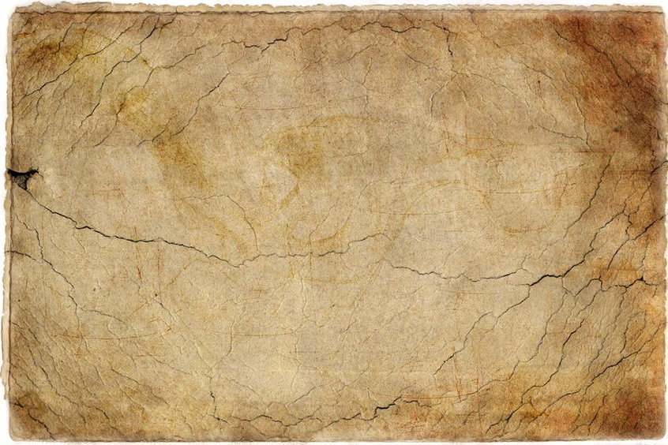

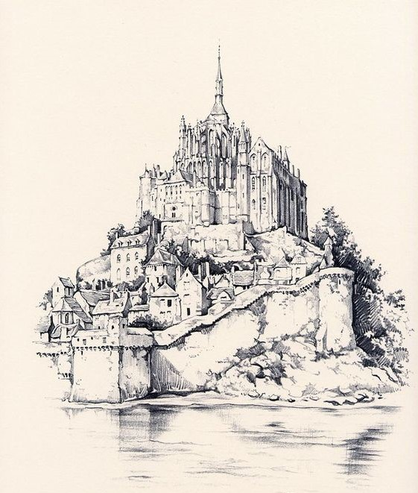
World of Narn.
A brief introduction to the
Figure 1 – The Abby of Ble on Narn [1]
Notes:
Title Page

Slide 2
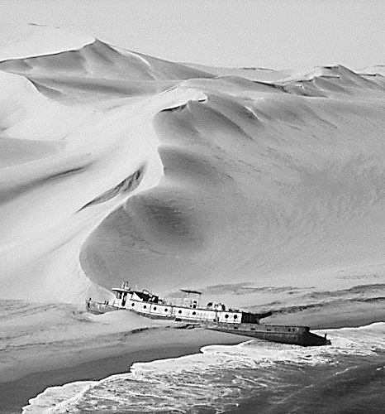
Contents
Introduction to the World of Narn.
Player Experience.
Theme.
Tone.
Game Mechanics.
Map.
History.
Civilizations.
Religion.
Geography.
References.
Figure 2 – Early photo of a weck on the Elnoch Coast. [2]
Notes:
Contents

Slide 3
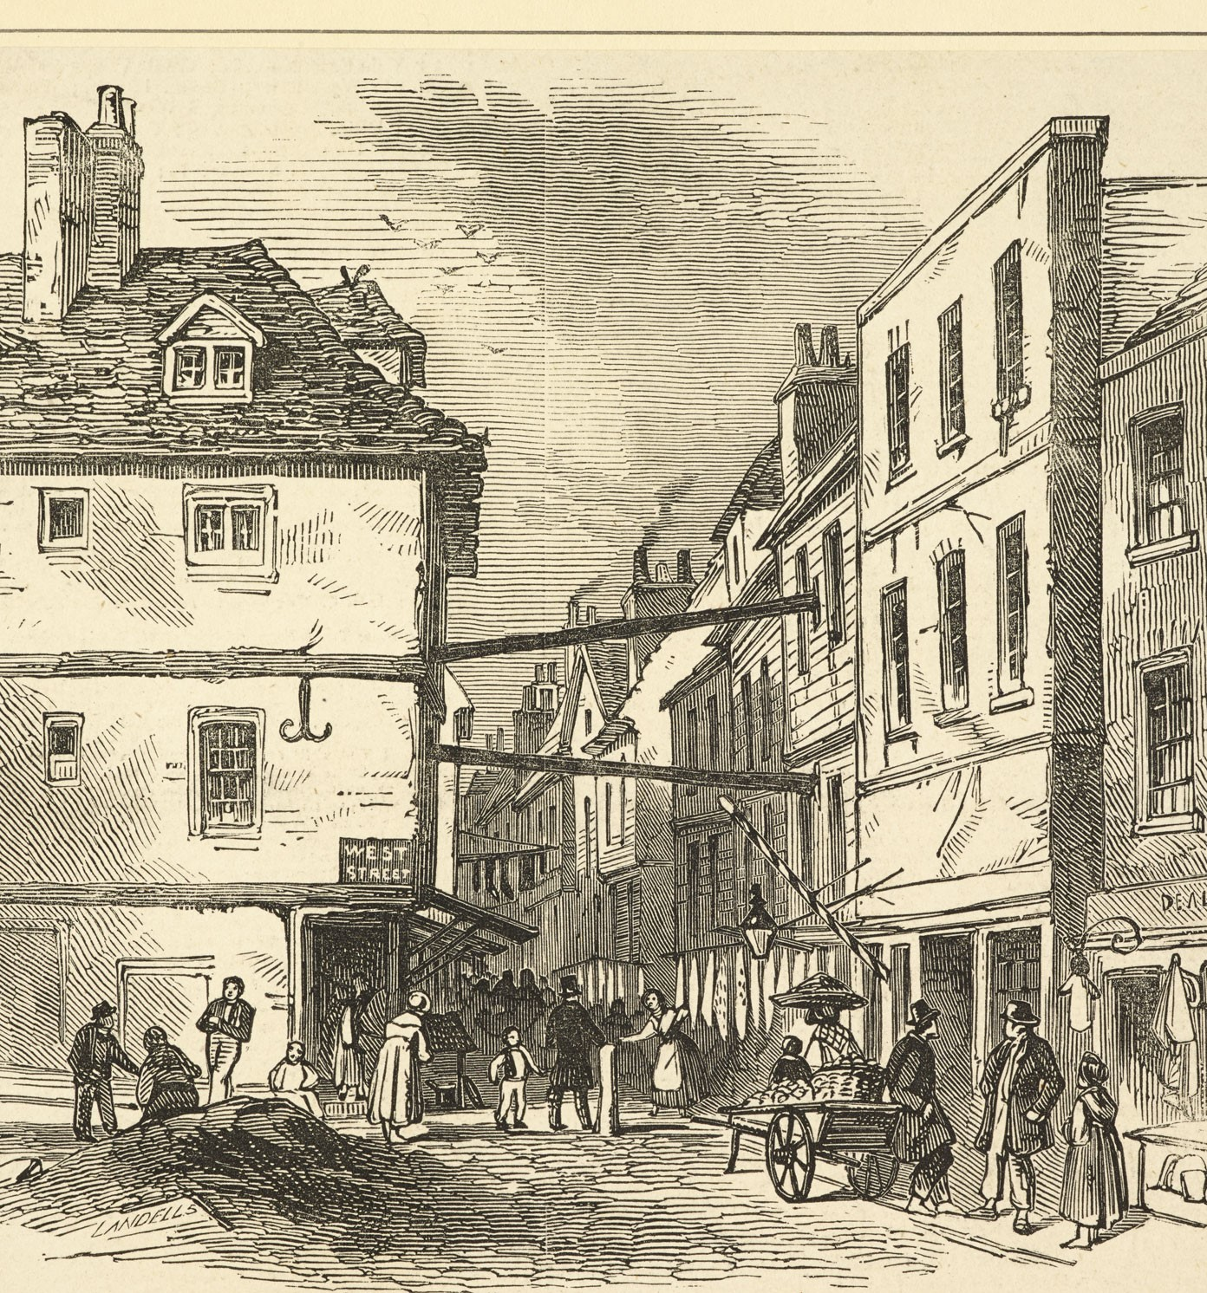
Introducing Narn
Narn is an emerging industrial world, with a technological level equivalent to that of the mid 18th century.
Due to recent events it is currently two mirrored worlds.
  Light Narn where there is very little evil.
  Dark Narn where there is very little good.
It is divided into two major continents, Uropa and Lessasia.
  The game would only focus on Uropa.
Figure 3 – A street
image from Salchester. [3]
Notes:
Latagore is useful for DLC

Slide 4
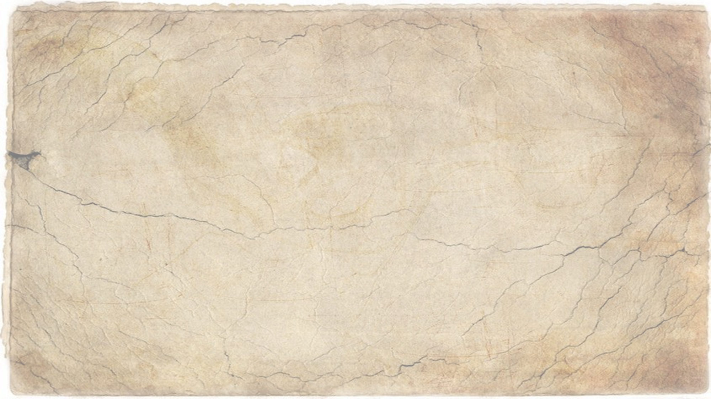
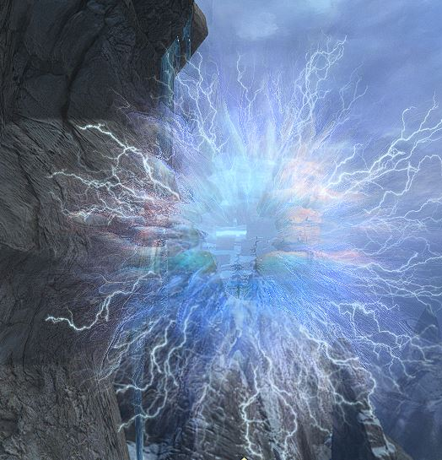
Player Experience
The player must enter rifts and close them.
Each area of the will feal different to you. You will need to use all the skills you learn to survive the harsher areas of Narn, like the Teeth of the World.
The player will also have to make hard choices that may go against there natural instincts. Forcing the player to examine their morality and how far are they willing to go to save the world.
Figure 4 – A light Rift. [4]

Slide 5
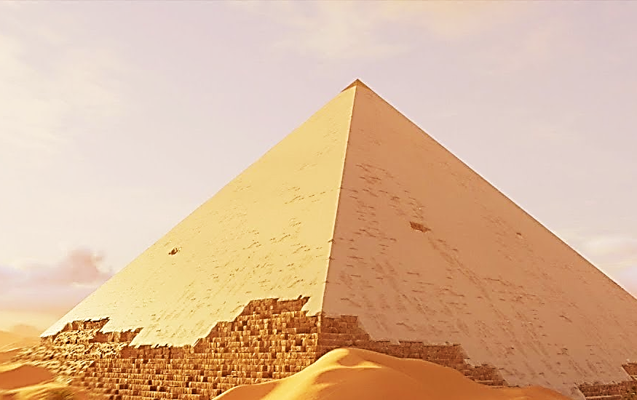

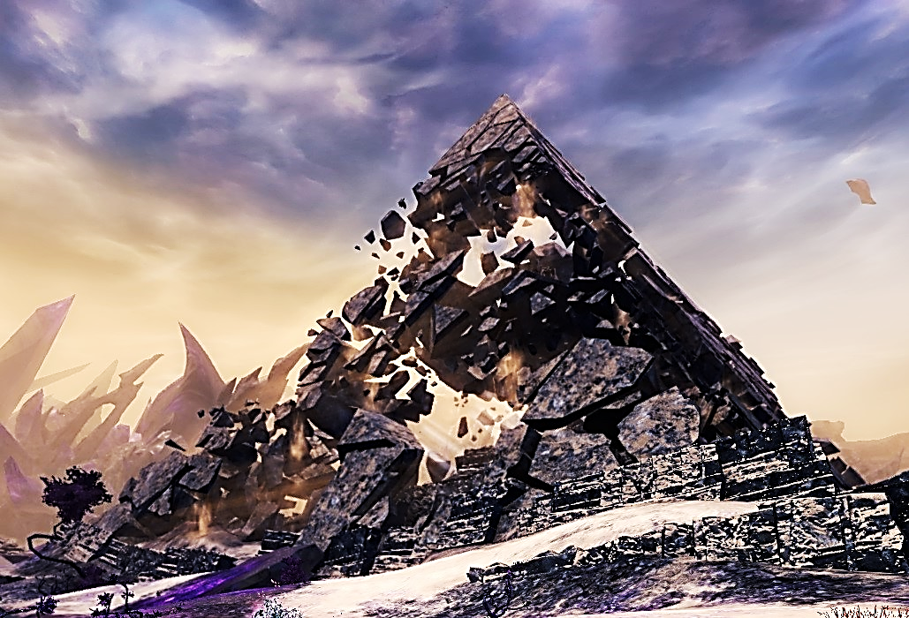
Theme
There are two main themes within the world of Narn. That of Balance and of Duality.
  Within the world of Narn there needs to be a balance of Dark and Light. With Ble he who is balance keeping the other two gods in check.
  The current state of the worlds that the player starts in is that there is no longer that balance as Ble is missing. His disappearance caused Narn to become two Narns one Light one Dark.
  If Balance is not restored both Narns will eventually be destroyed .
  You as the player will not only have to do good (i.e be the hero) but do evil as well to ensure that you maintain the balance as you play.
  Light and Dark are linked what affects one will affect the other.
Figure 5 (Top) – Ancient Elnoch Pyramid on Light Narn. [5]
Figure 6 (Bottom) - Ancient Elnoch Pyramid on Dark Narn. [6]

Slide 6
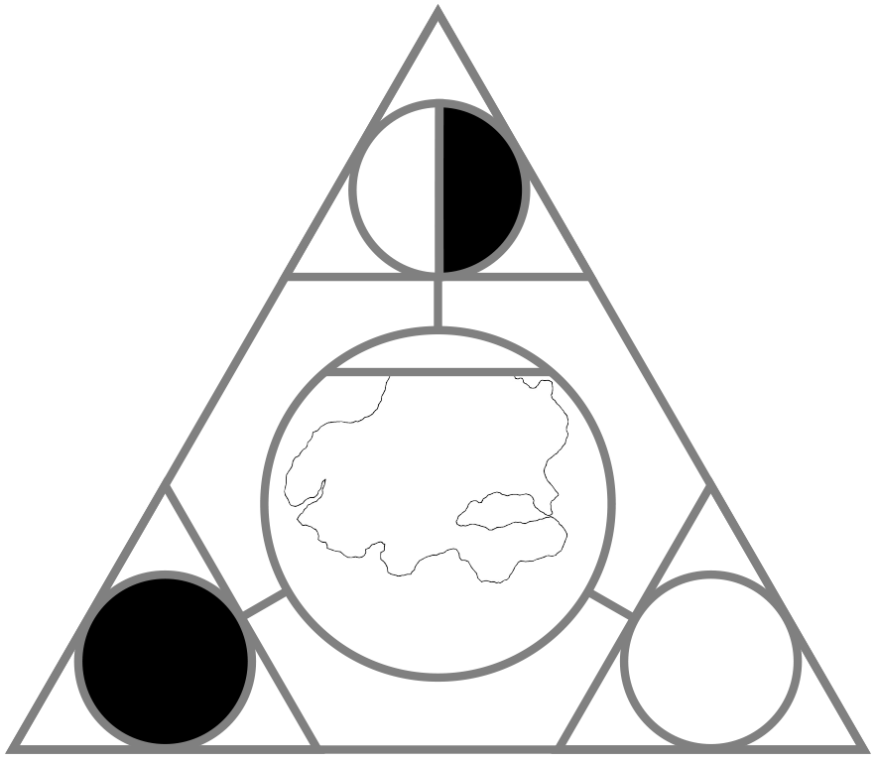
Tone
The Tone of the world depends on where you are and how you are doing.
Light Narn has a hopeful and pure tone.
Dark Narn feels a lot more oppressive.
The only exceptions to this are at the entrance to the rifts.
  If a rift is on Light Narn the area around it will feel oppressive this is because darkness is flowing through it from Dark Narn. Like wise a rift on Dark Narn will have a much more light and hopeful feeling in the area around it.

Slide 7
Game Mechanics
The Rifts the player enters will have different mechanics depending on what region of the world their in.
  In Elnoch you will have to play through platforming levels avoiding traps and pitfalls etc…
  In Kaijaing you will use stealth to sneak past guards to reach your goal.
  In Southsungia you will battle heroes of legend in the same style as a street fighter game.
As the game progresses the rifts will increase in difficulty with the hardest ones being found on Dark Narn.
Other Mechanics include but not limited to.
  Leveling.
  Side quests.
  Movements.

Slide 8
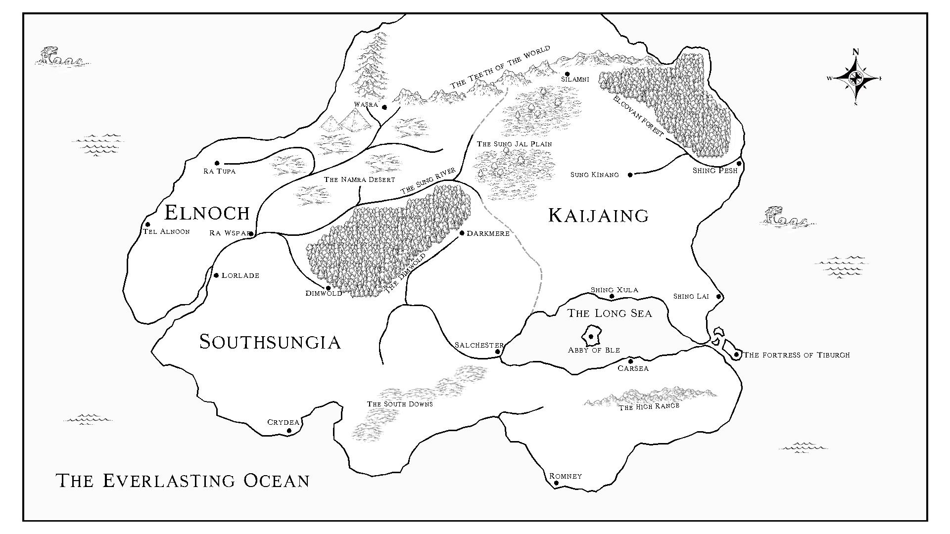
The Continent of Uropa

Slide 9
The History of Narn
  Before the Split (BS)
Lessasia is covered in a great fog and becomes known as the Hidden Realm, it is slowly forgotten.
Also at about this time Southsungia becomes the dominant power on Uropa.
The three gods of Creation take form.
754 – 727 BS
The war of the Southen Kingdom’s between Southsungia and Latagore takes place .Resulting in Latagore embarking on the great migration to Lassasia.
Around 500,000 BS
Around 30,000 BS
5,000 BS
1,000 BS
Akka goddess of Light, and Ukko god of Dearness form the first life.
Ble he who is Balance forms the world of Narn.
The great continent of Laurasia splits apart forming the continents of Uropa and Lessasia.
The Kingdom’s of Elnoch, Kaijaing, Latagore and Southsungia rise on Uropa.
681 BS
Before 1,000,000 BS

Slide 10
The History of Narn
  After the Split (AS)
He who is Balance vanishes. With no one to maintain the balance Narn splits to form Light Narn, and Dark Narn.
261 AS
Corruption begins to seep through the Rifts. Slowly turning Light into Dark, and Dark into Light.
On Light Narn a child is bourn in one of the Kingdoms. (Player character)
Around 100 AS
174 AS
228 AS
234 AS
On Dark Narn Elnoch and Kaijaing declare war on Southsungia.
This war becomes known as Sung River War.
The first temporary Rifts are discovered it is unknown how long they have been forming before this.
Both worlds begin to experience more and more Natural Diesters. It is theorised these are caused by the Rifts opening and closing.
The first permeant Rift forms in Elnoch.
The Abby of Ble is formed, They begin preaching the end of the world with out his return
283 AS
Before 0 AS
Present Day

Slide 11
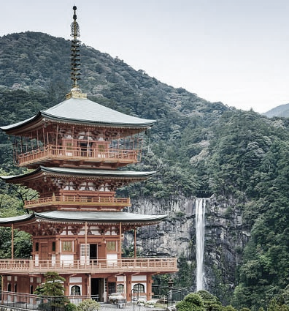
Civilizations
It has four major civilizations.
  Elnoch loosely based on Egyptian culture.
  Kaijaing loosely based on Japanese culture.
  Southsungia loosely based on English culture.
  Latagore lost in history.
Figure 7 – Elcovan Forest in Kaijaing. [7]

Slide 12
Religion
It follows three major gods.
  Akka the Goddess of Light.
  Ukko the God of Darkness.
    Akka and Ukko are Brother and Sister.
  Ble he who is Balance.

Slide 13
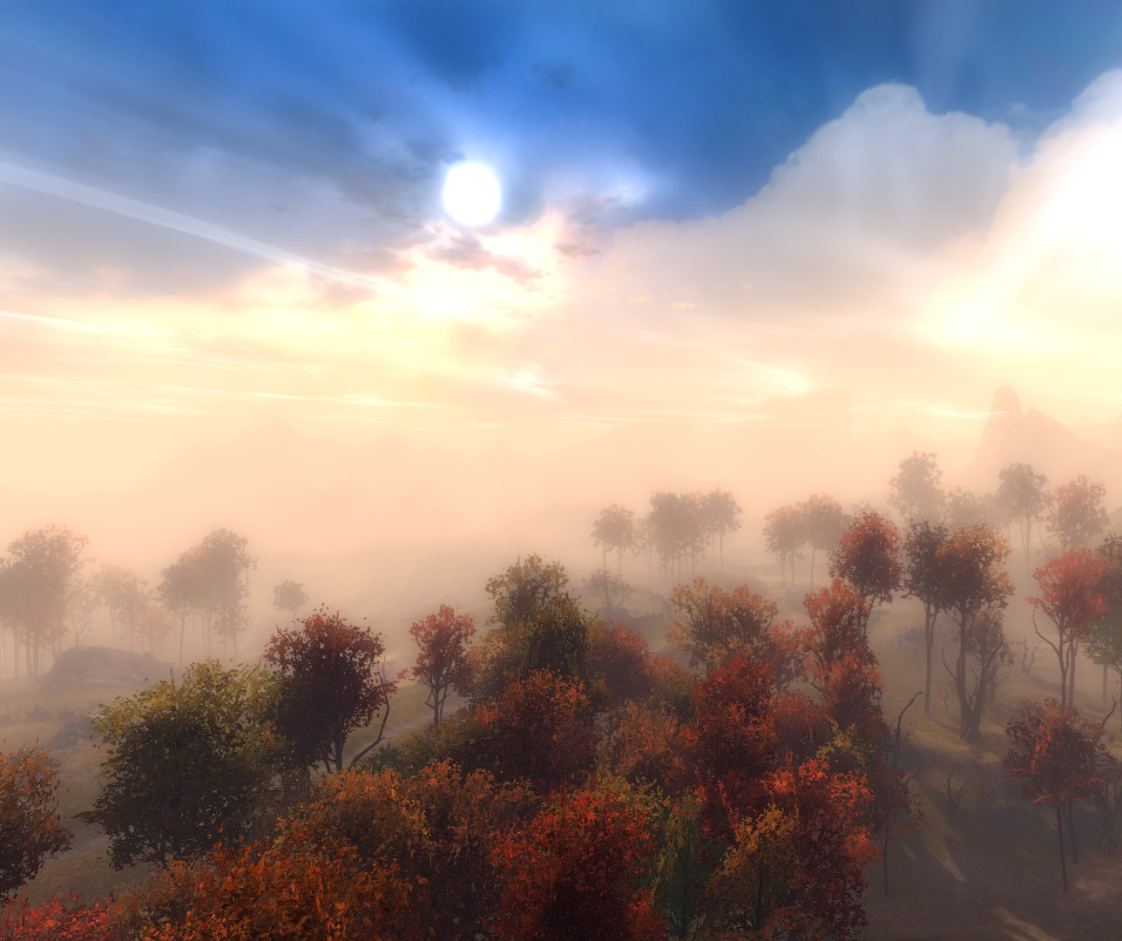
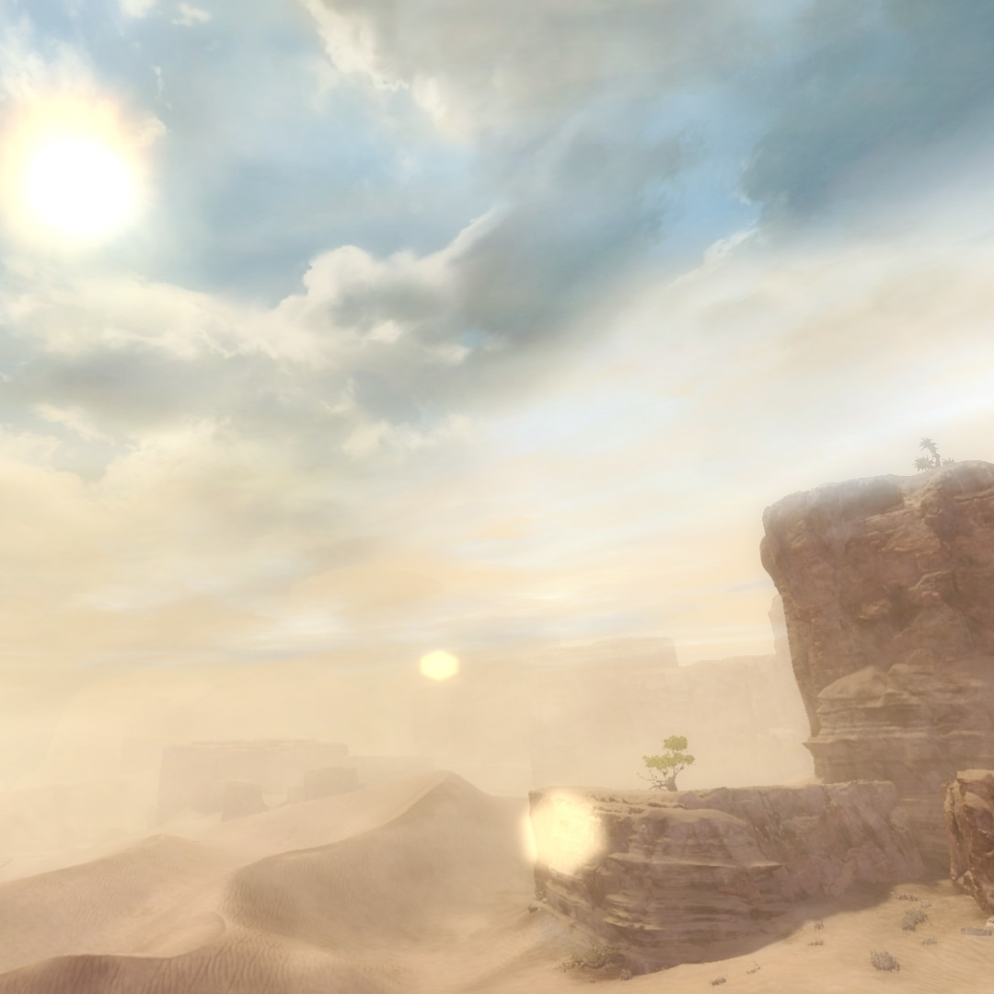
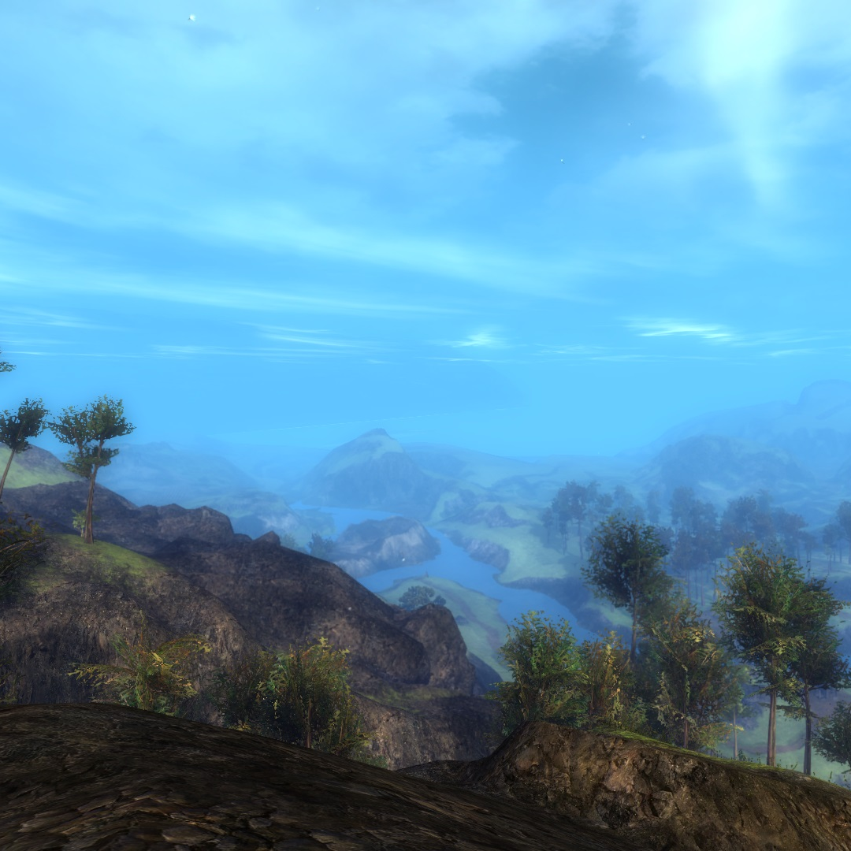
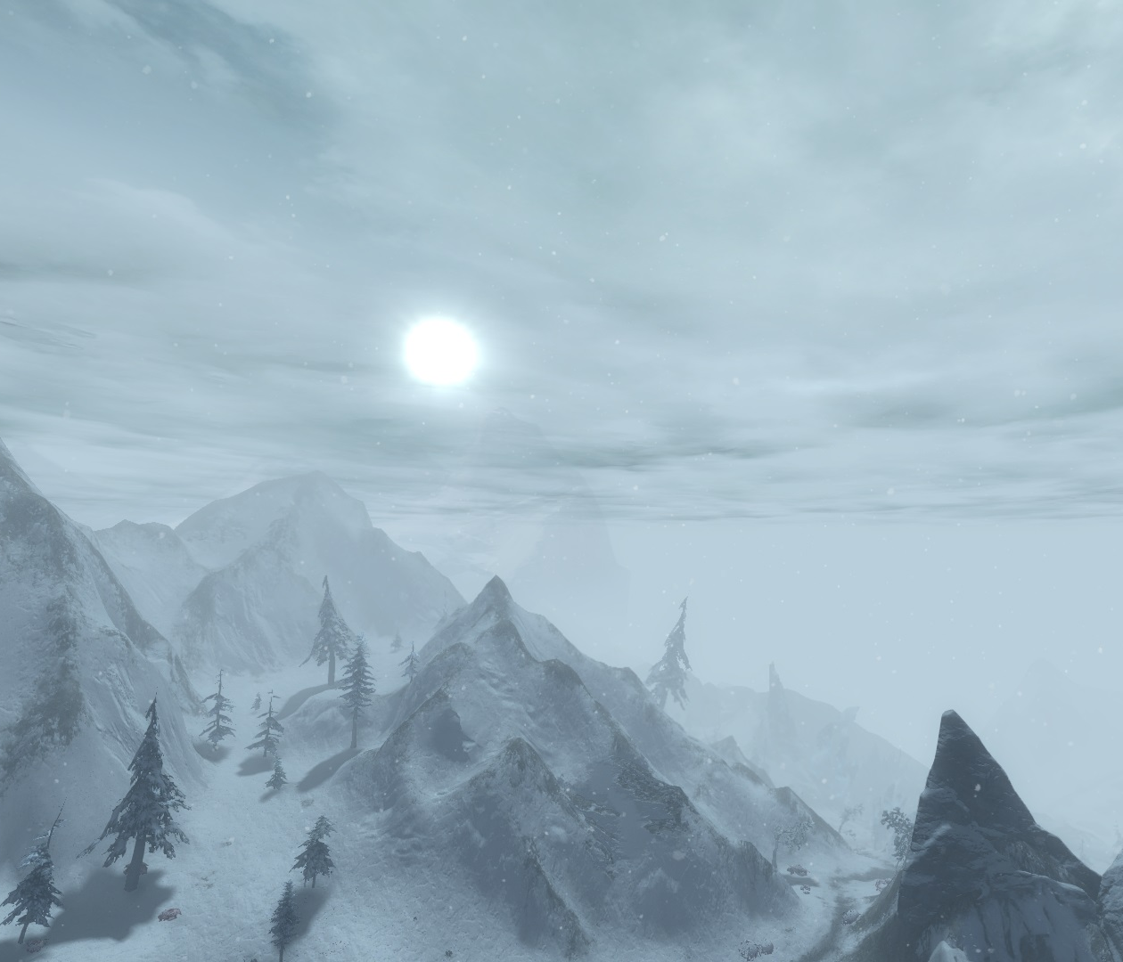

Geography
The content of Uropa is made up of 4 distant biomes.
    Elnoch is mostly desert with flood planes around the rivers.
    Kaijaing is more arid grass and woodland.
    Southsungia is mainly rolling green hills.
    North of the Teeth of the World is a cold snow-covered mountain region.
Figure 8 (Top Left) – Eloch. [8]
Figure 9 (Top Right) Kaijaing. [9]
Figure 10 (Bottom Left) Southsungia. [10]
Figure 11 (Bottom Right) The Teeth of the World .[11]

Slide 14
References
Images
  [1] – Mont Saint-Michel, France (online image) (https://www.pinterest.co.uk/pin/218354281913581888/)
  [2] – Shipwreck of the Skeleton Coast, Namibia (online image) (https://www.ervinskalameraphotos.com/wp-content/uploads/2011/09/Shipwreck-Skeleton-Coast-Namibia-732x500.jpg)
  [3] – Field Lane, London (online image) (https://www.bl.uk/britishlibrary/~/media/bl/global/dl%20romantics%20and%20victorians/collection-item-images/u/n/k/unknown%20engraving%20b20105%2015.jpg)
  [4] – Hero point challenge, Icebound Plunge, Guild Wars 2 [Arenanet] (In game screen shot)
  [5] – Great Pyramid of Giza, Assassin’s creed origins [Ubisoft Montreal] (online image) (https://www.cibdol.com/img/cms/Blog/blog-banners/11.jpg)
  [6] – Hero point challenge, The Teratohedron, Guild Wars 2 (In game screen shot)
  [7] – Pagoda, Japan (online image) (https://www.cibdol.com/img/cms/Blog/blog-banners/11.jpg)
  [8] – Sifuri Sand Sea, Guild Wars 2 (In game screen shot)
  [9] – Freewain Pastures, Guild Wars 2 (In game screen shot)
  [10] – Queensdale, Guild Wars 2 (In game screen shot)
  [11] – Dredgehaunt Cliffs, Guild Wars 2 (In game screen shot)

